Slide 1

Data Analysis & Visualization Final Project
Team Members:
Ashay Shah
Mansi Khanna
Nirav Gori

Slide 2
Introduction:
Dataset is available at:
https://www.kaggle.com/datasets/stefanoleone992/fifa-22-complete-player-dataset
Project objective:
Preliminary analysis to understand our data
Clean the data & apply analytical techniques using python
Pick the appropriate features for our visualization
Formulate problem statements for analysis & create visuals on Tableau to get essential insights
Utilizing MS Excel for data aggregations execute consistency checks
Advanced exploratory data analysis, to understand the correlations between features

Slide 3

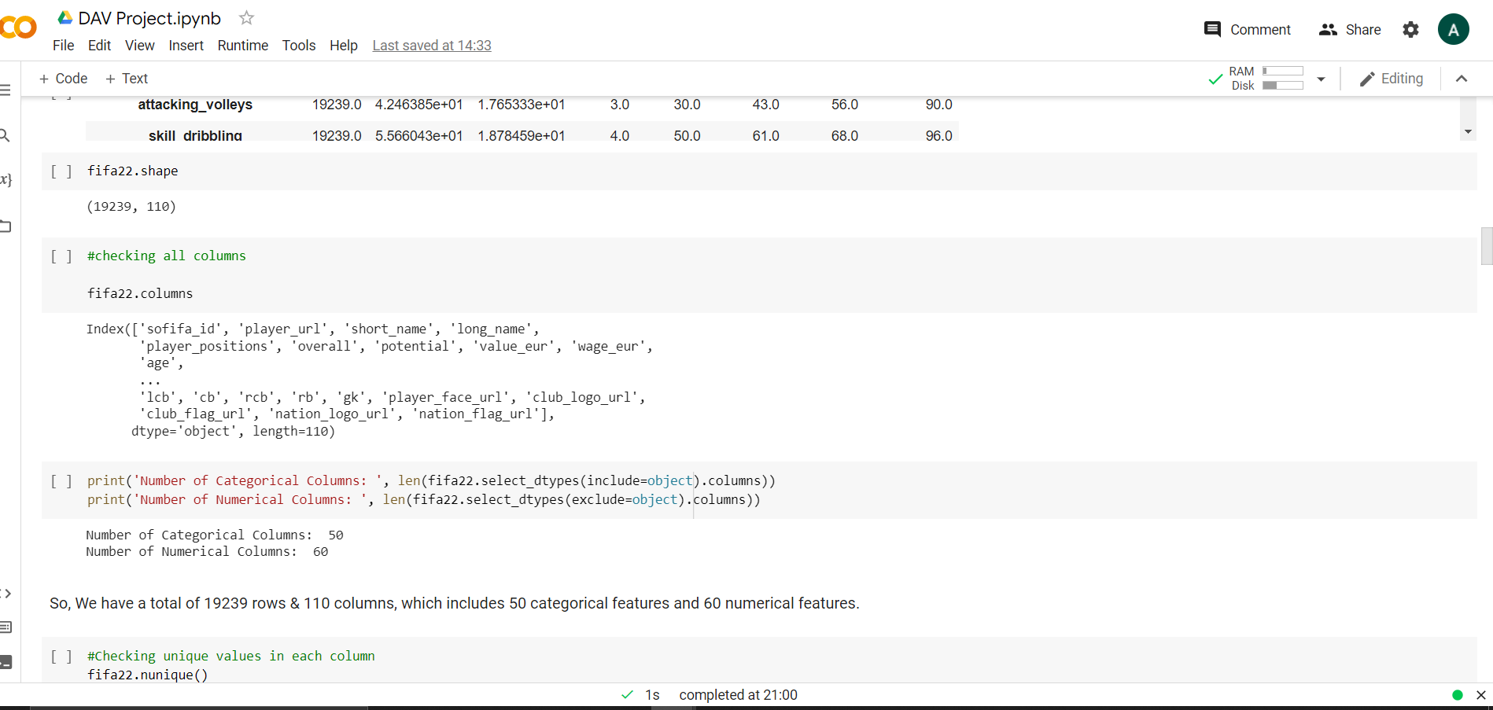
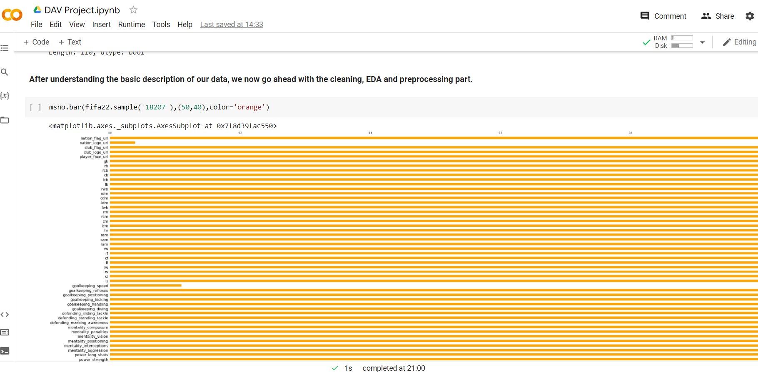
Data description using Python:

Slide 4
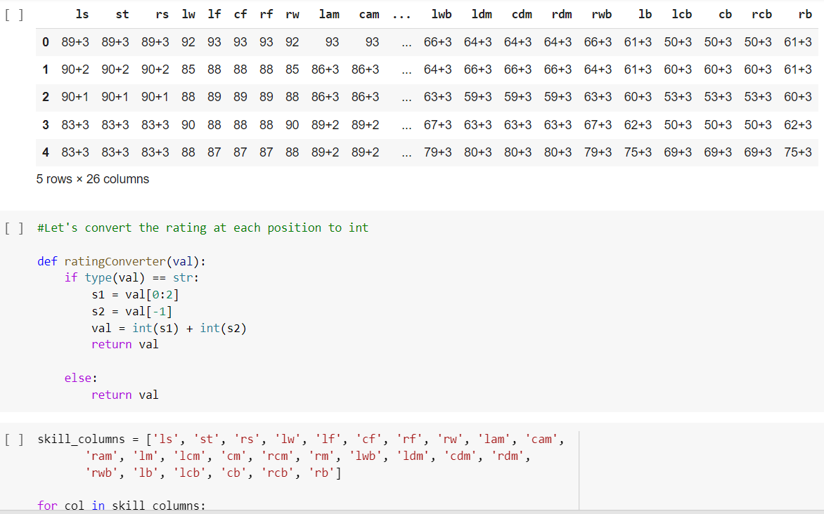
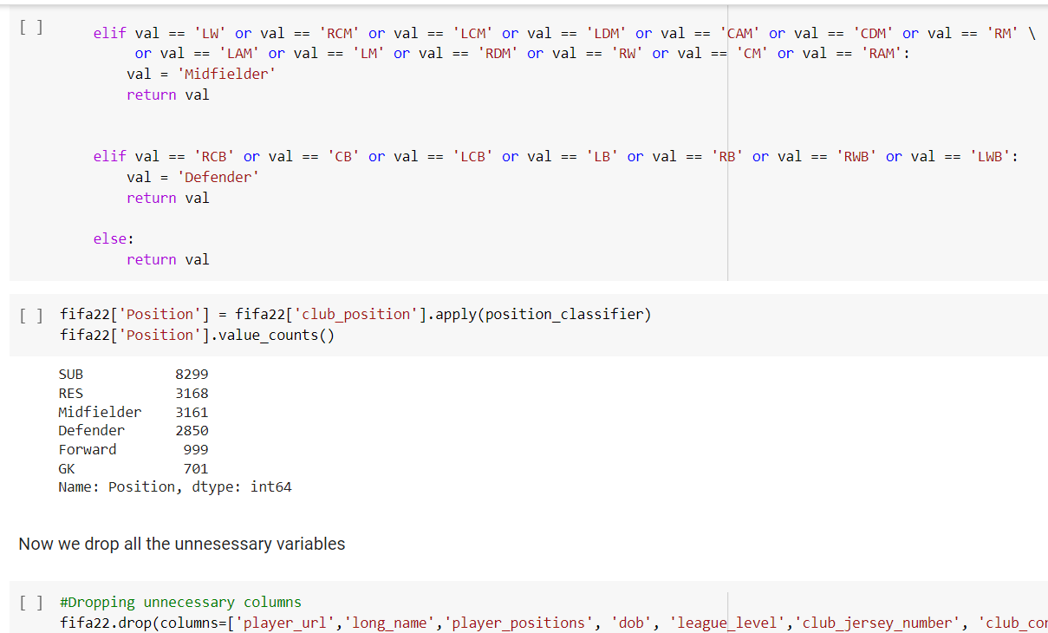

Slide 5
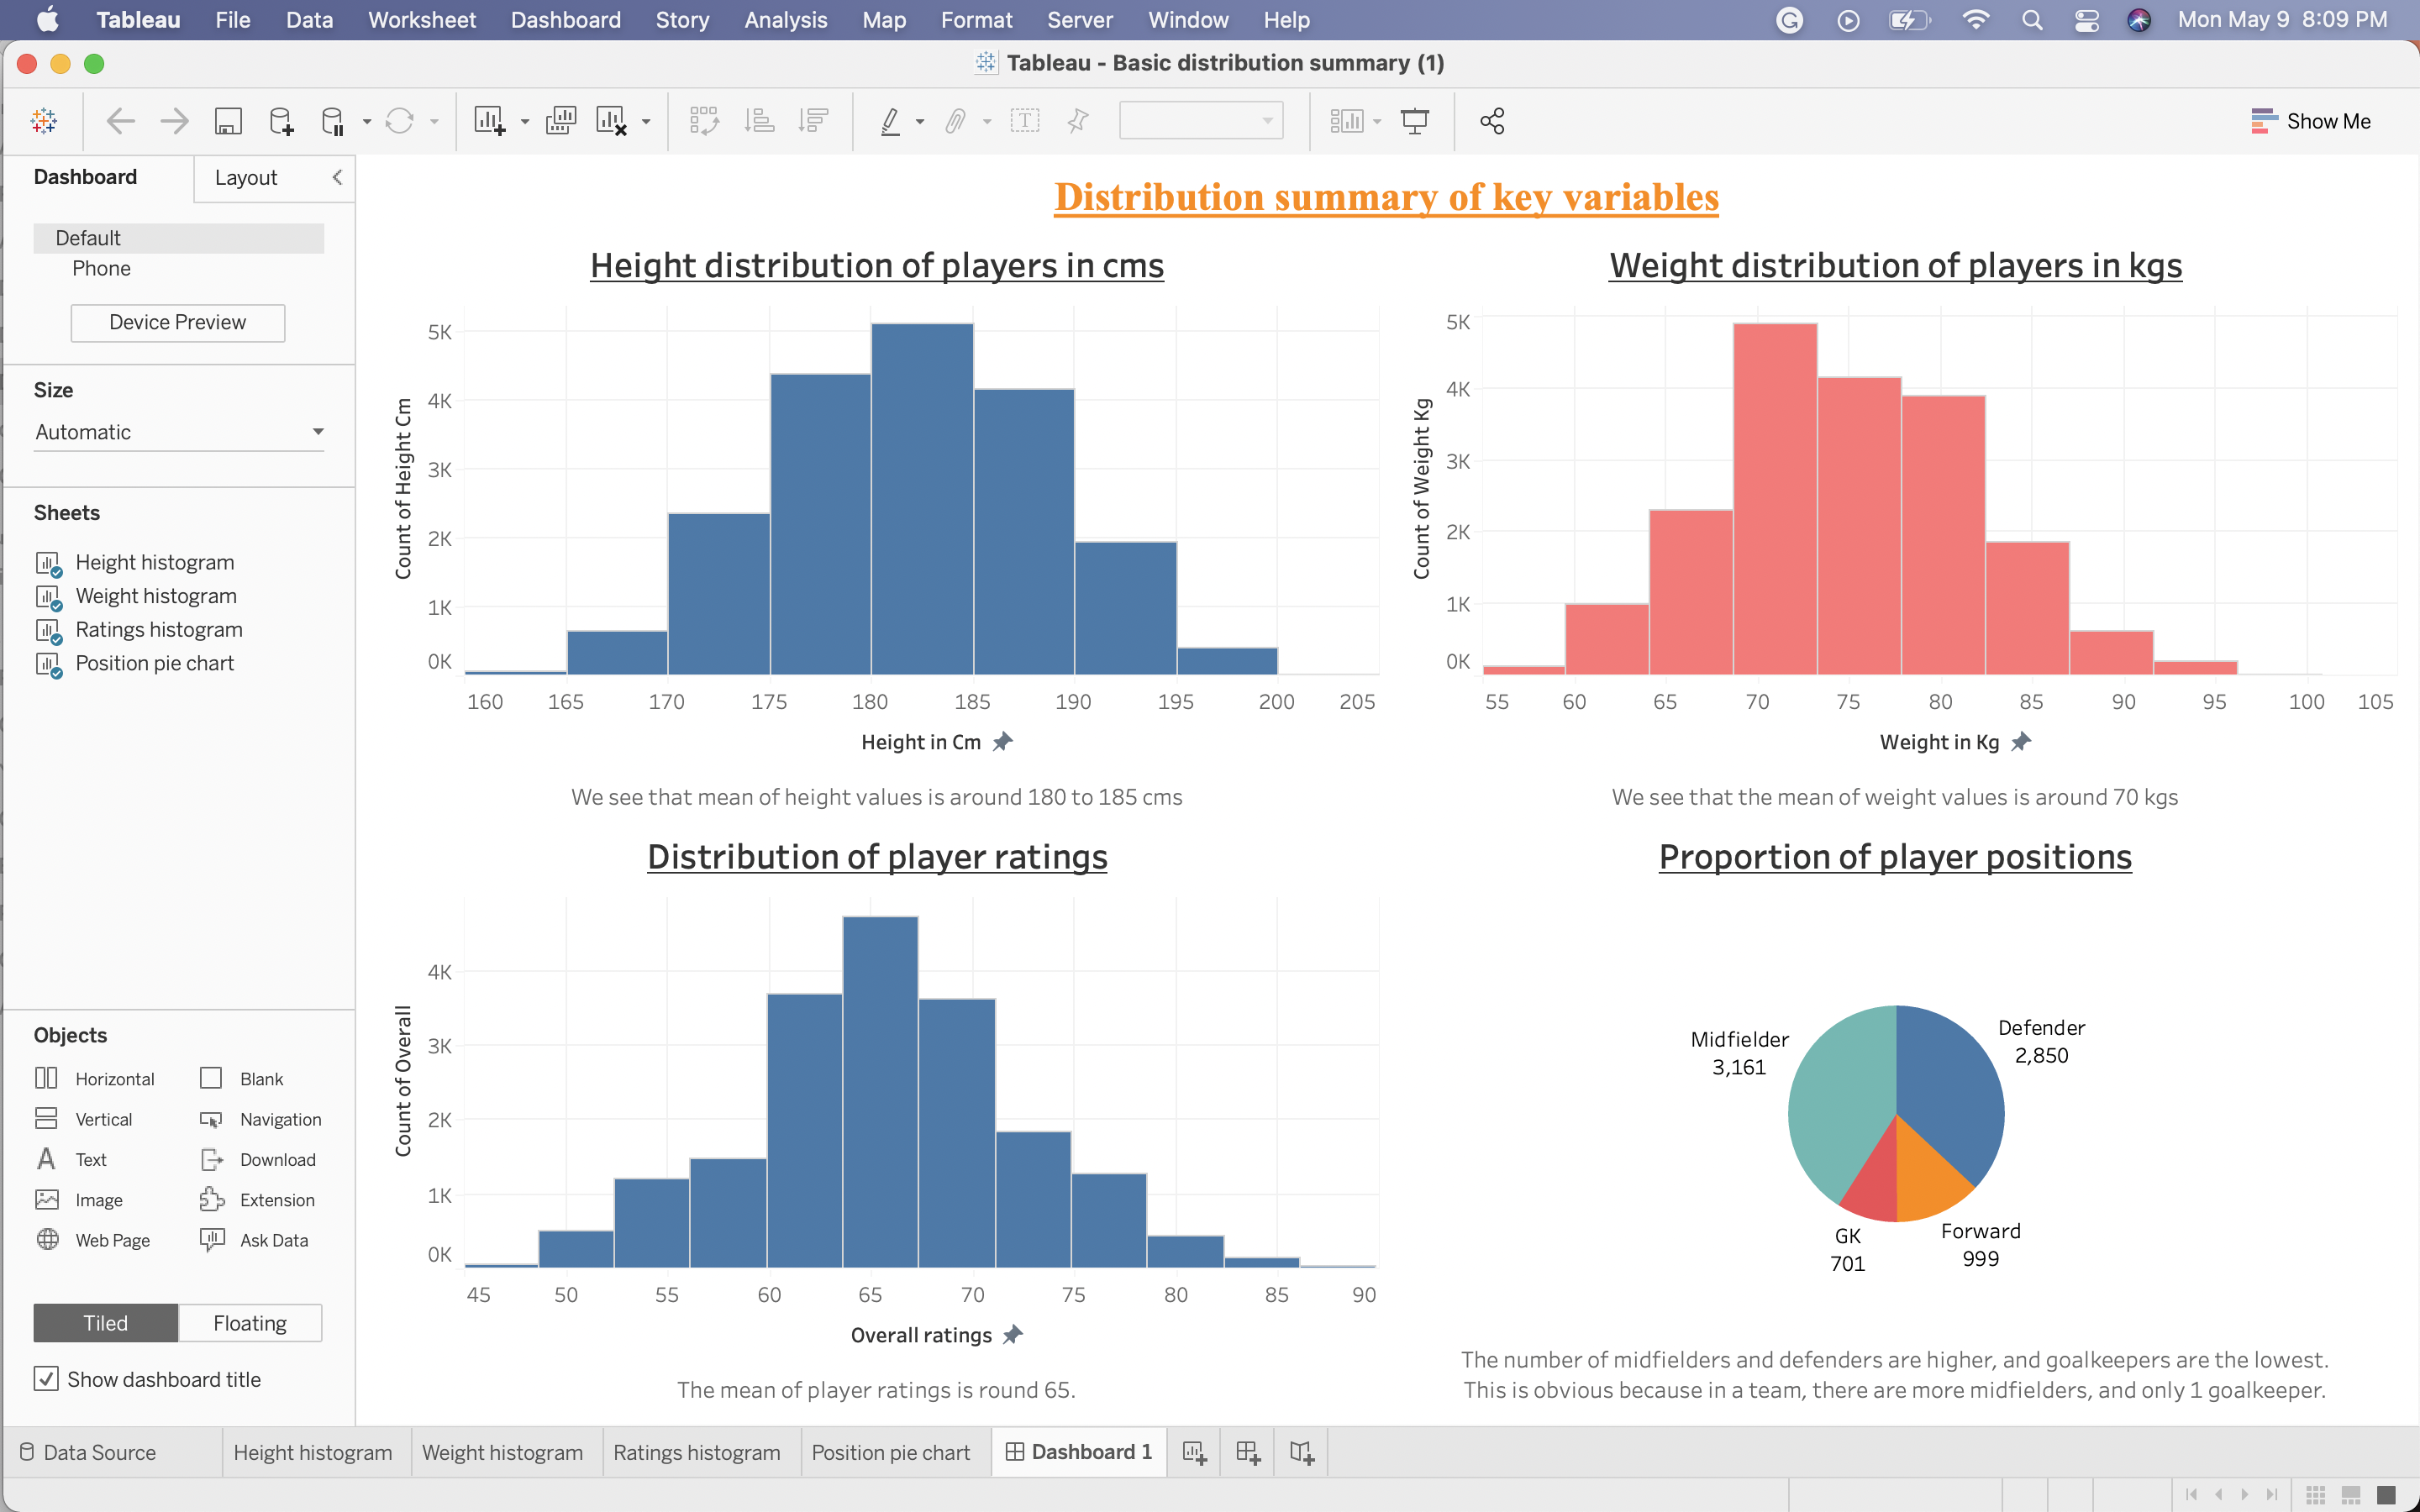
Dashboard 1:

Slide 6
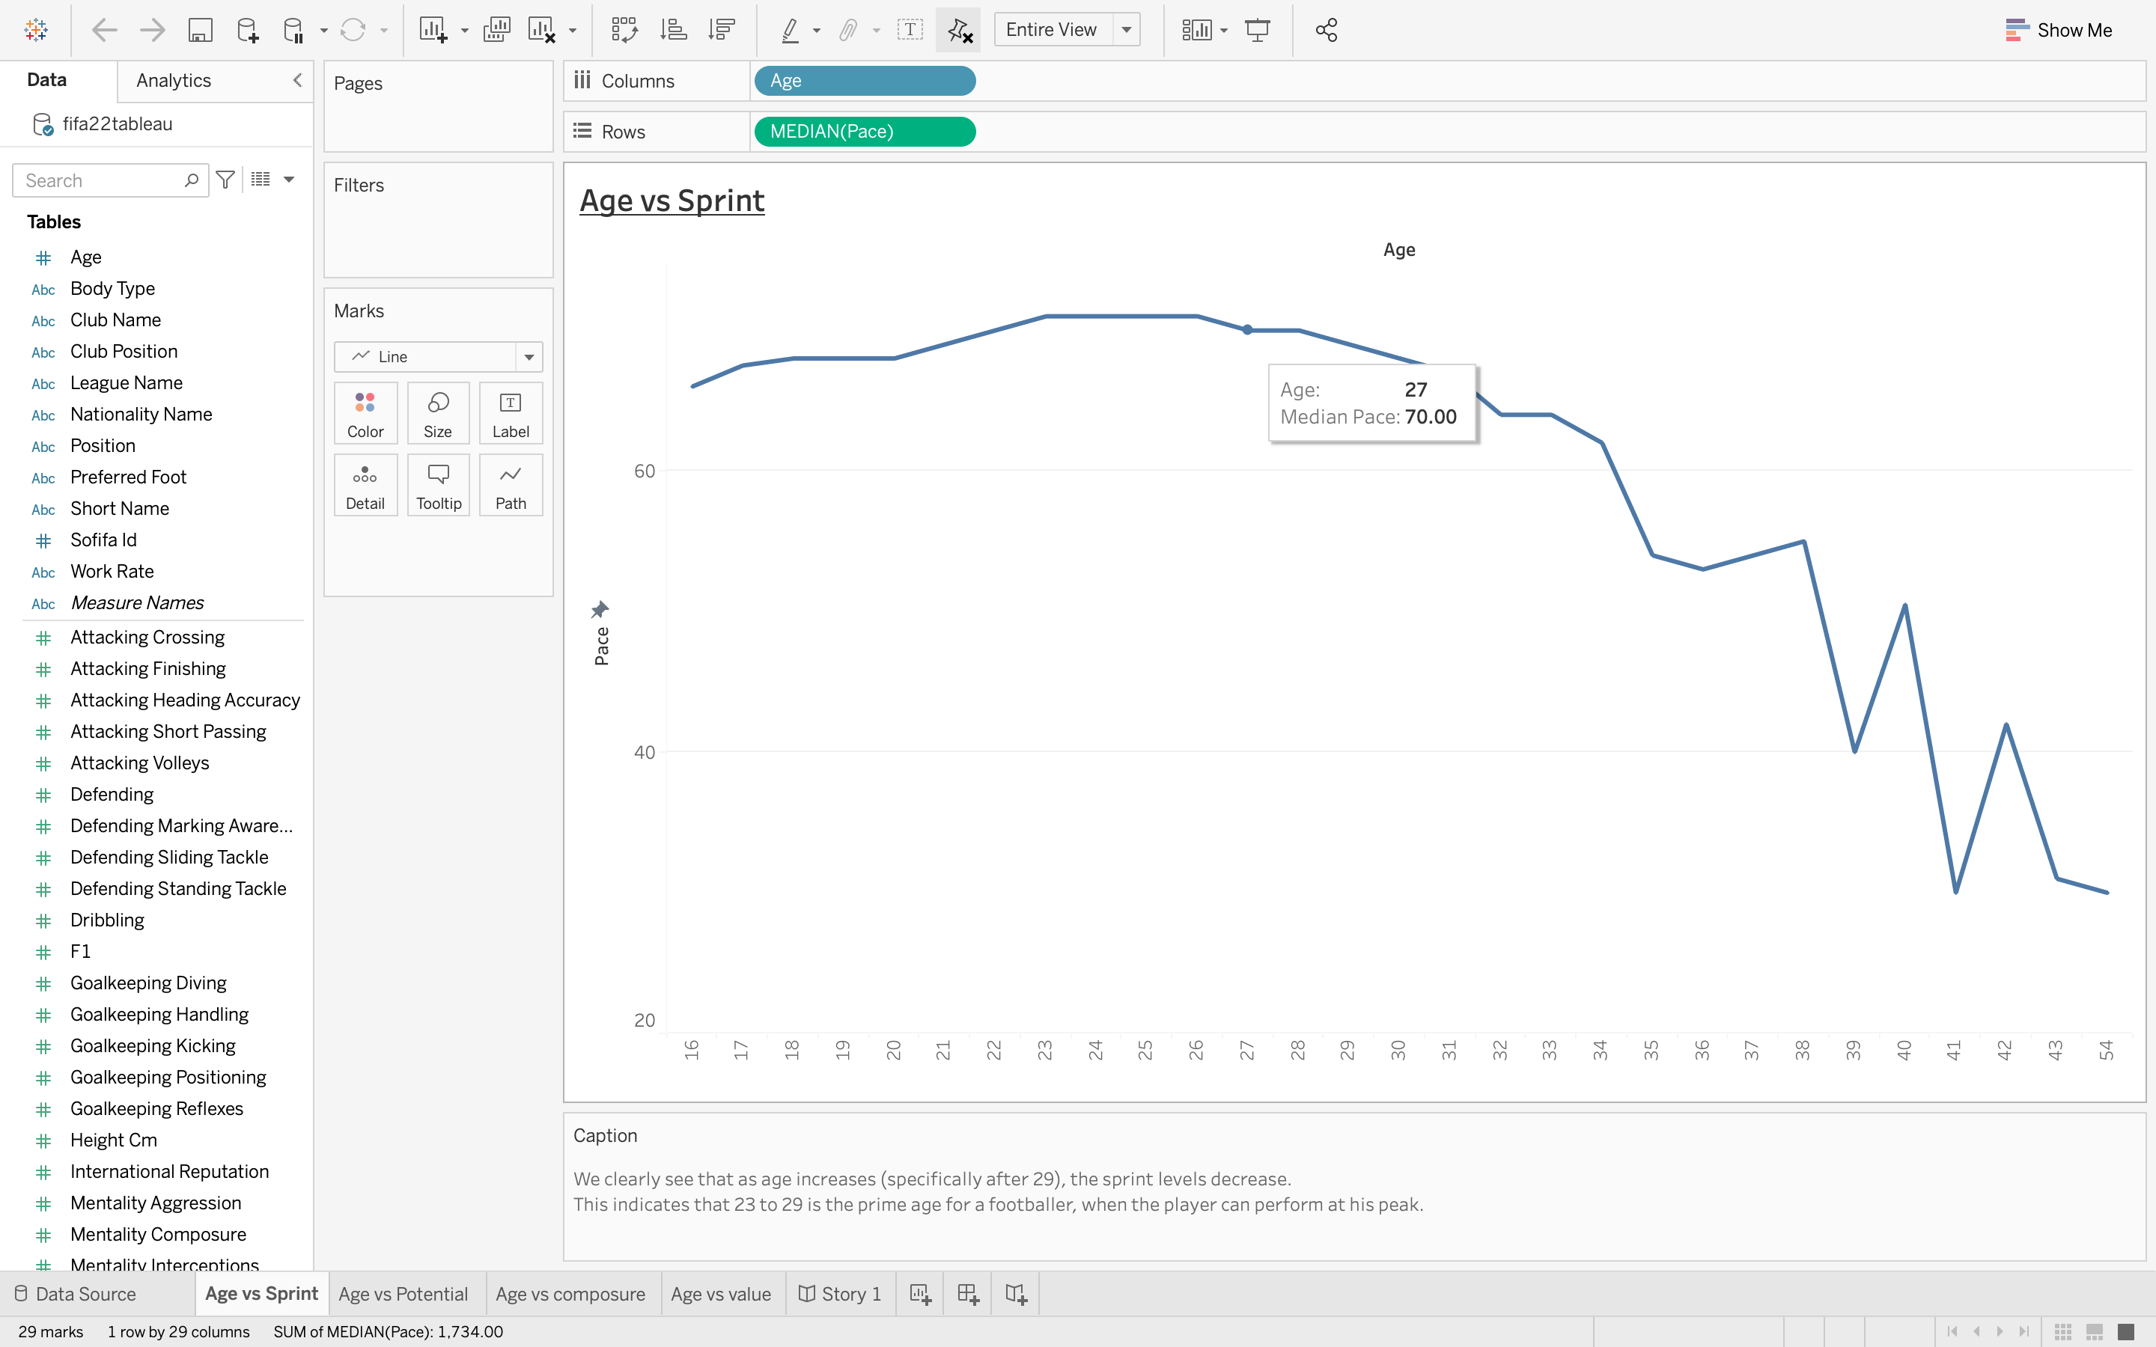
Story 1 -

Slide 7
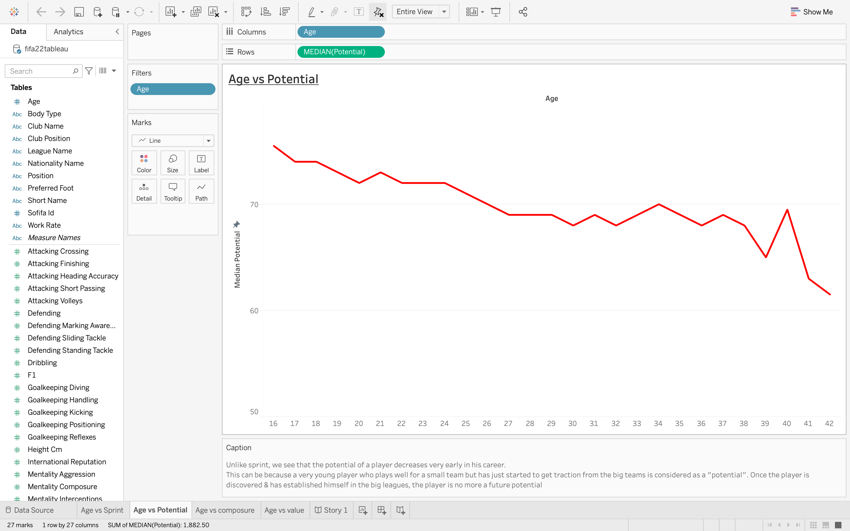

Slide 8
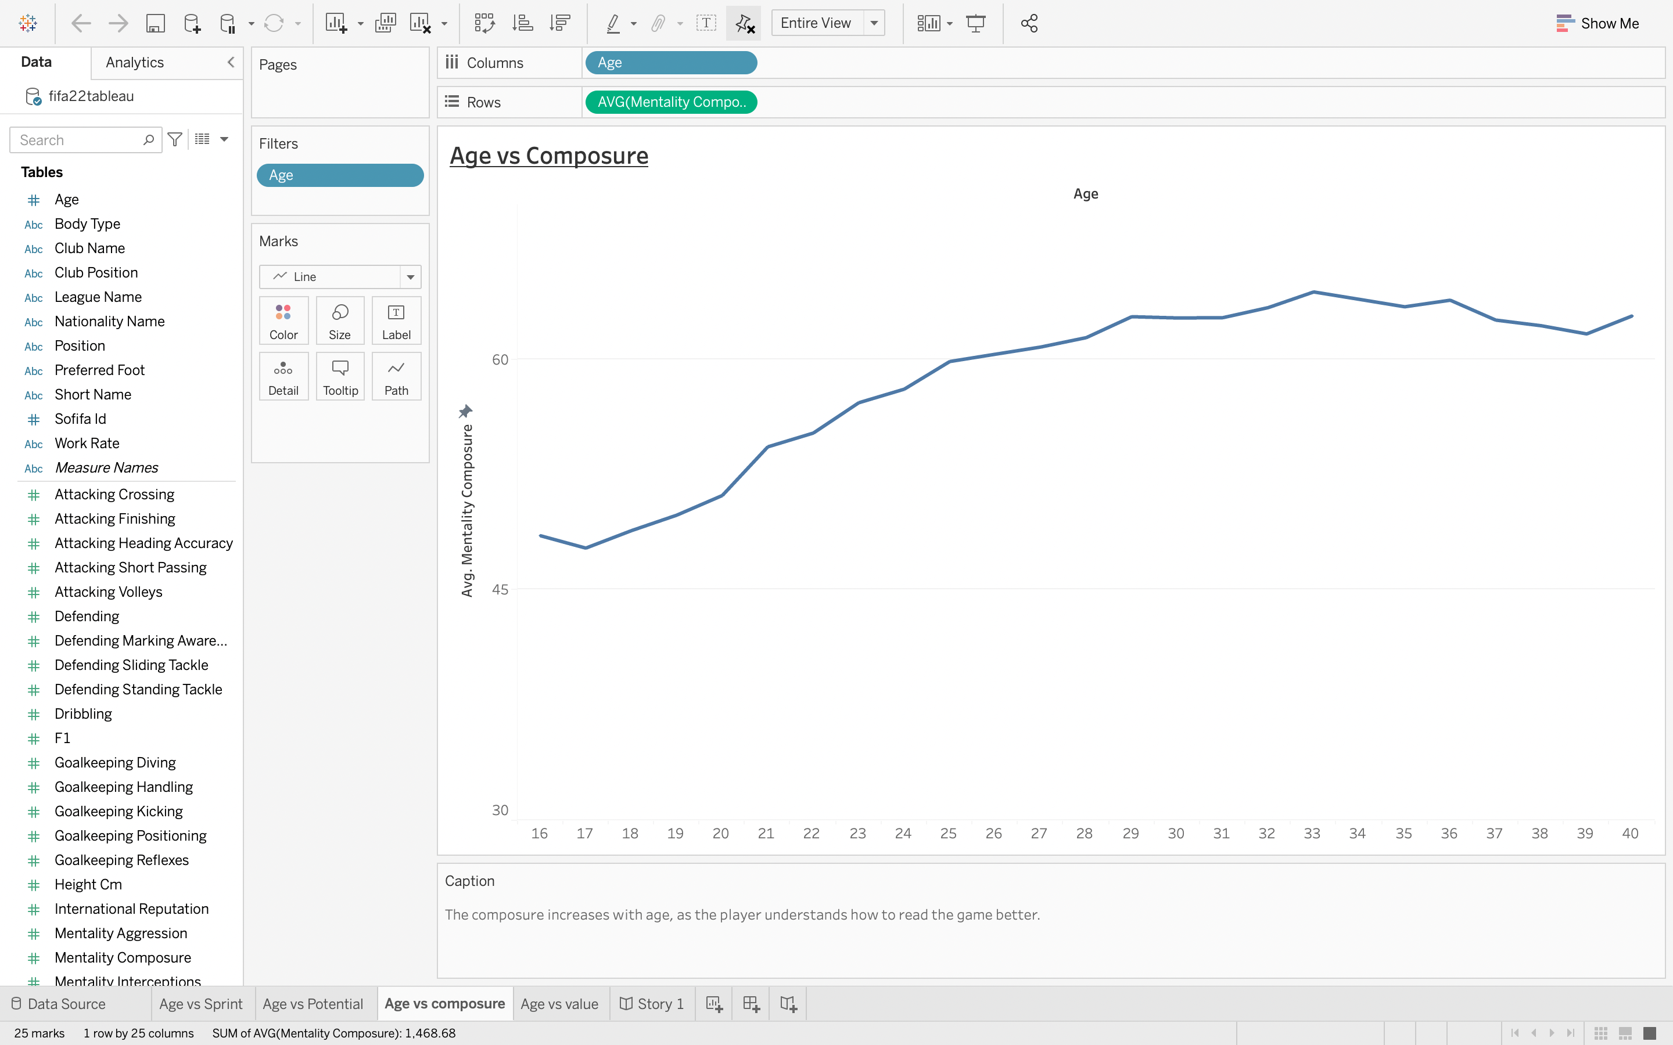

Slide 9
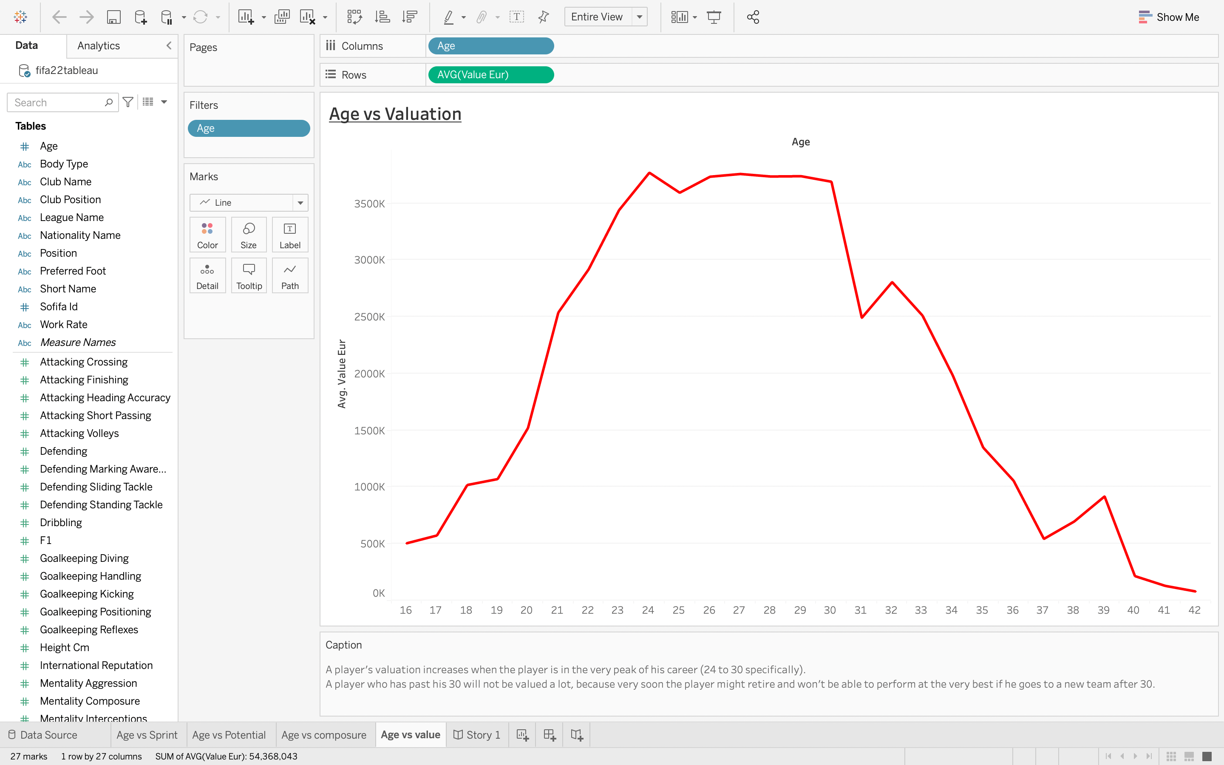

Slide 10
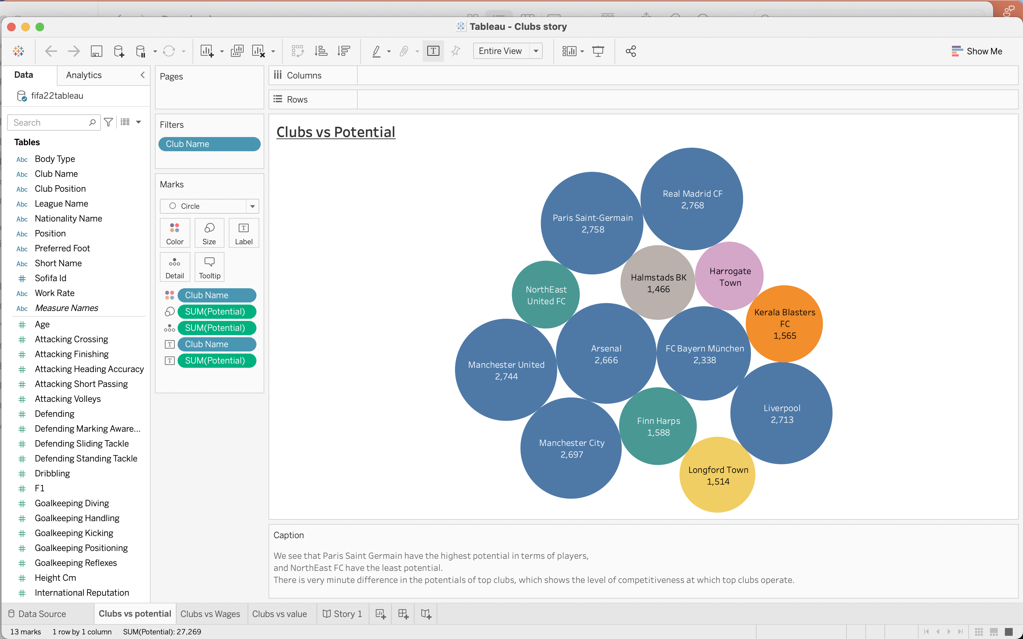
Story 2:

Slide 11
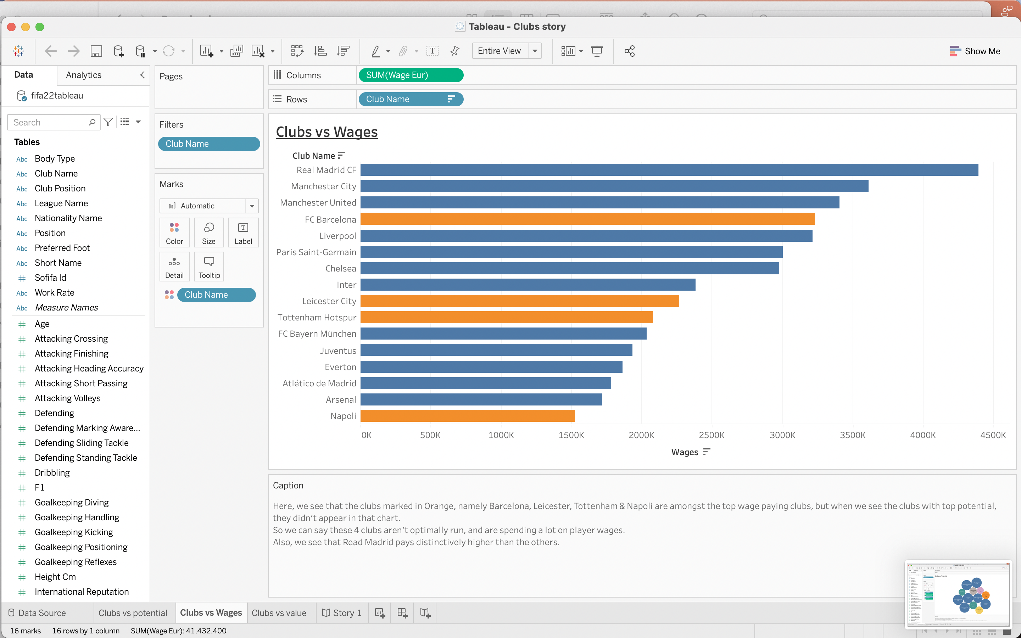

Slide 12
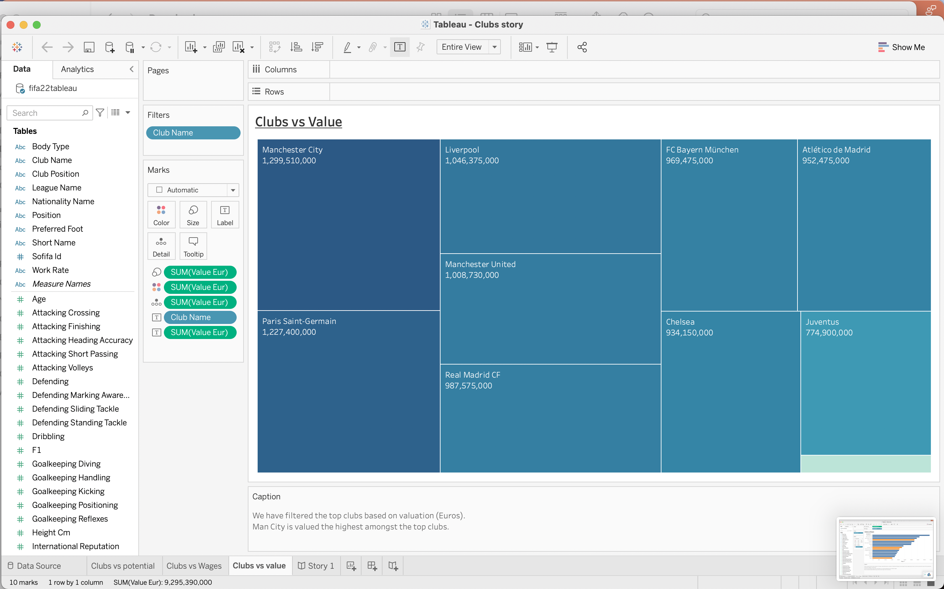

Slide 13
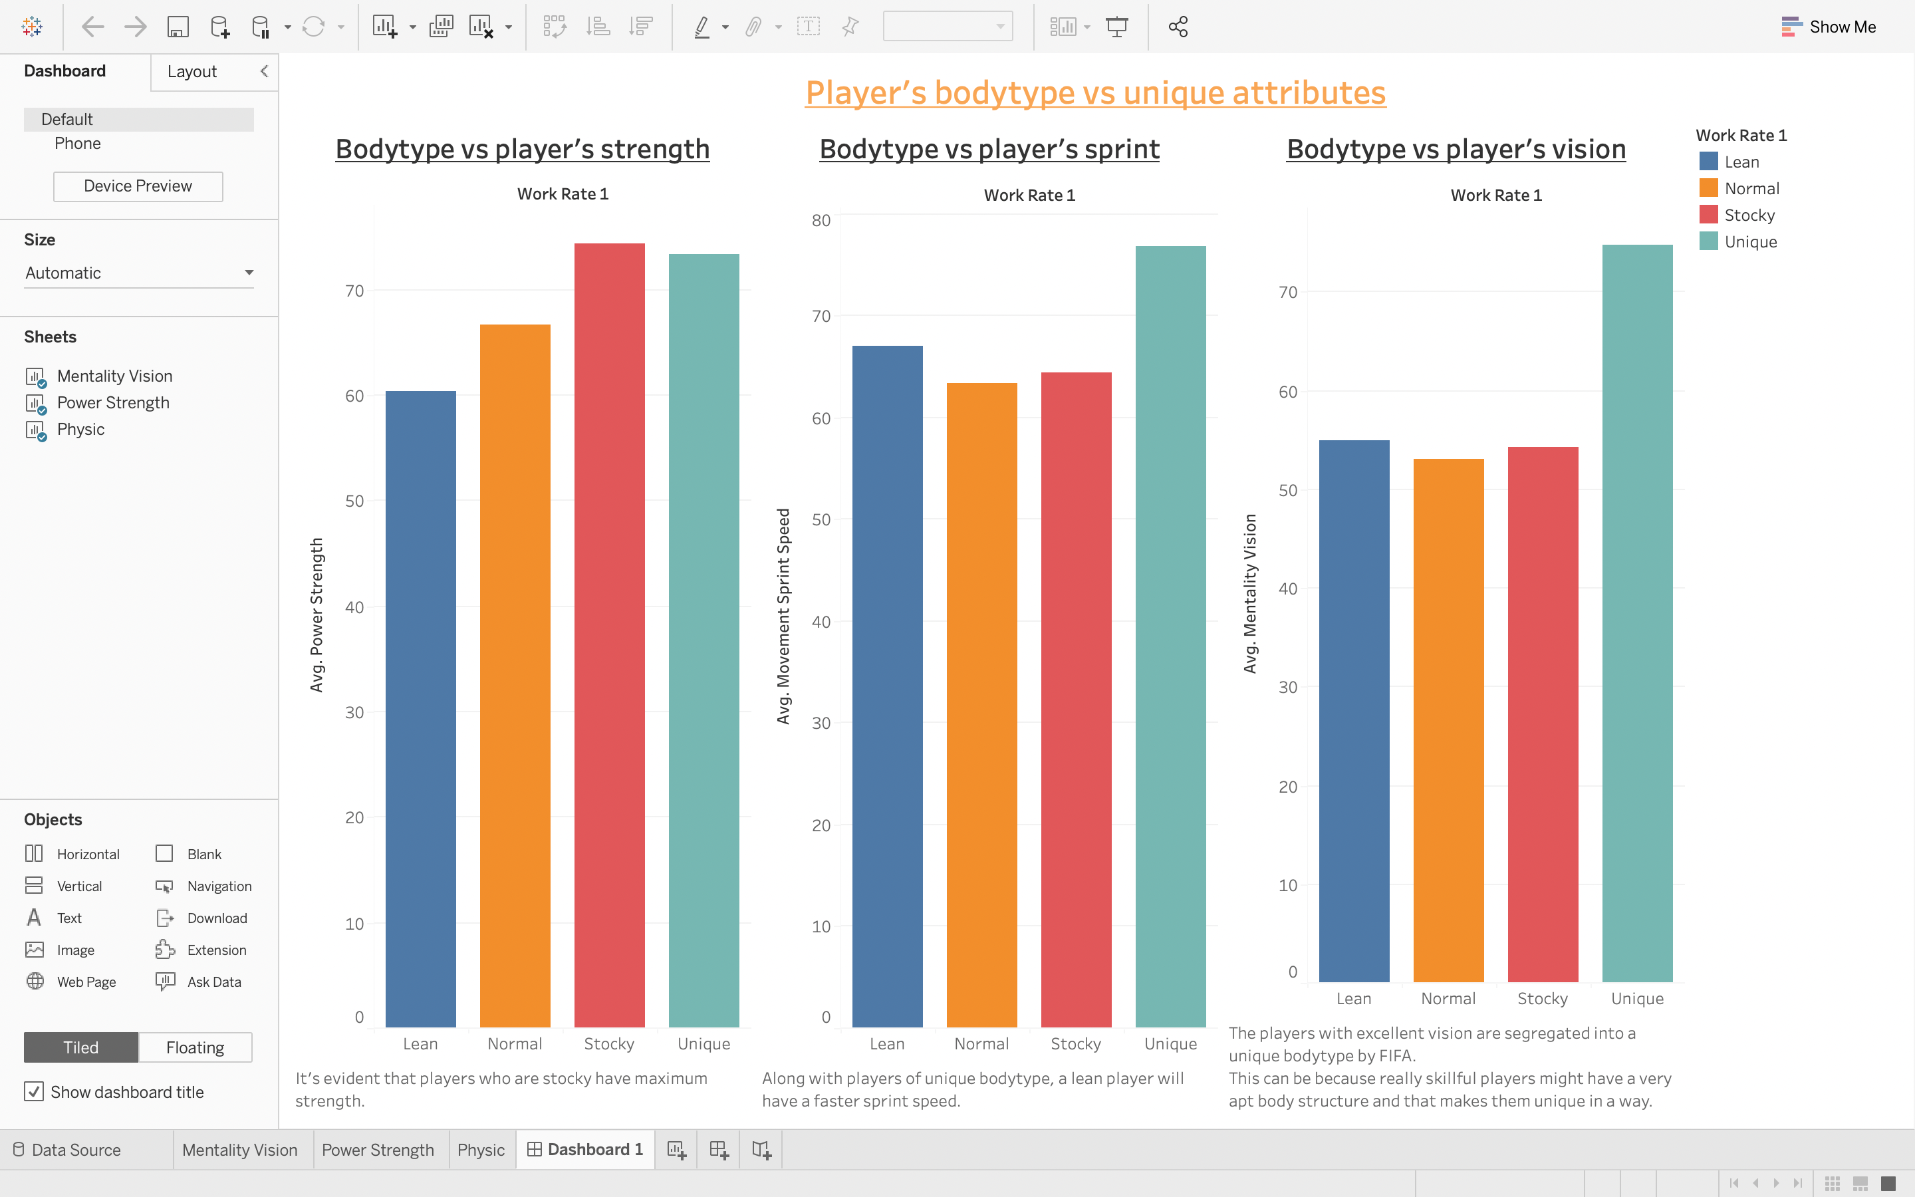
Dashboard 2

Slide 14
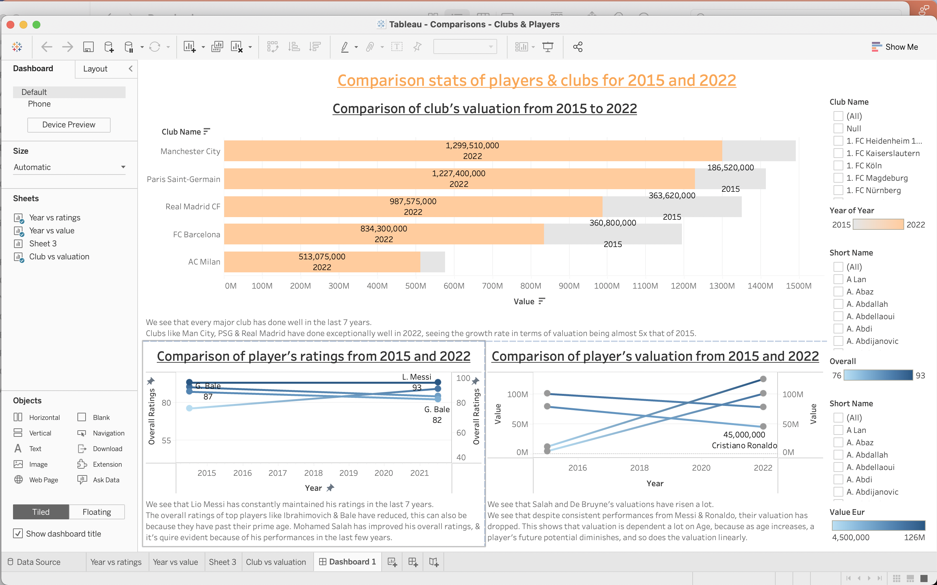
Dashboard 3

Slide 15
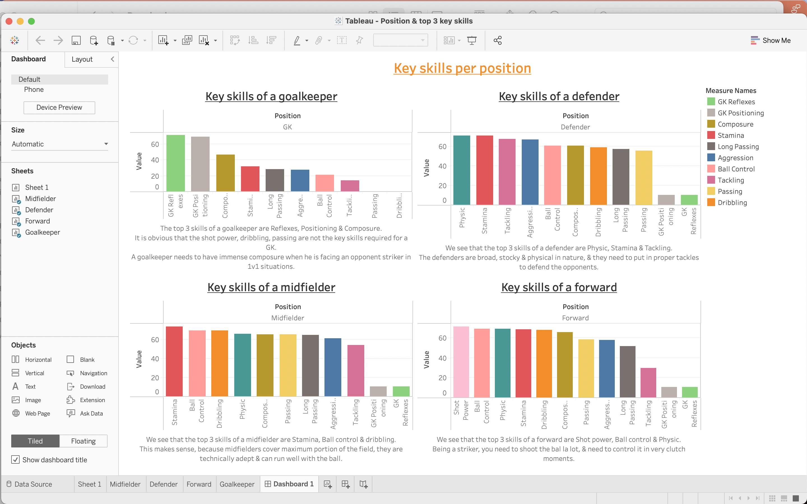
Dashboard 4

Slide 16
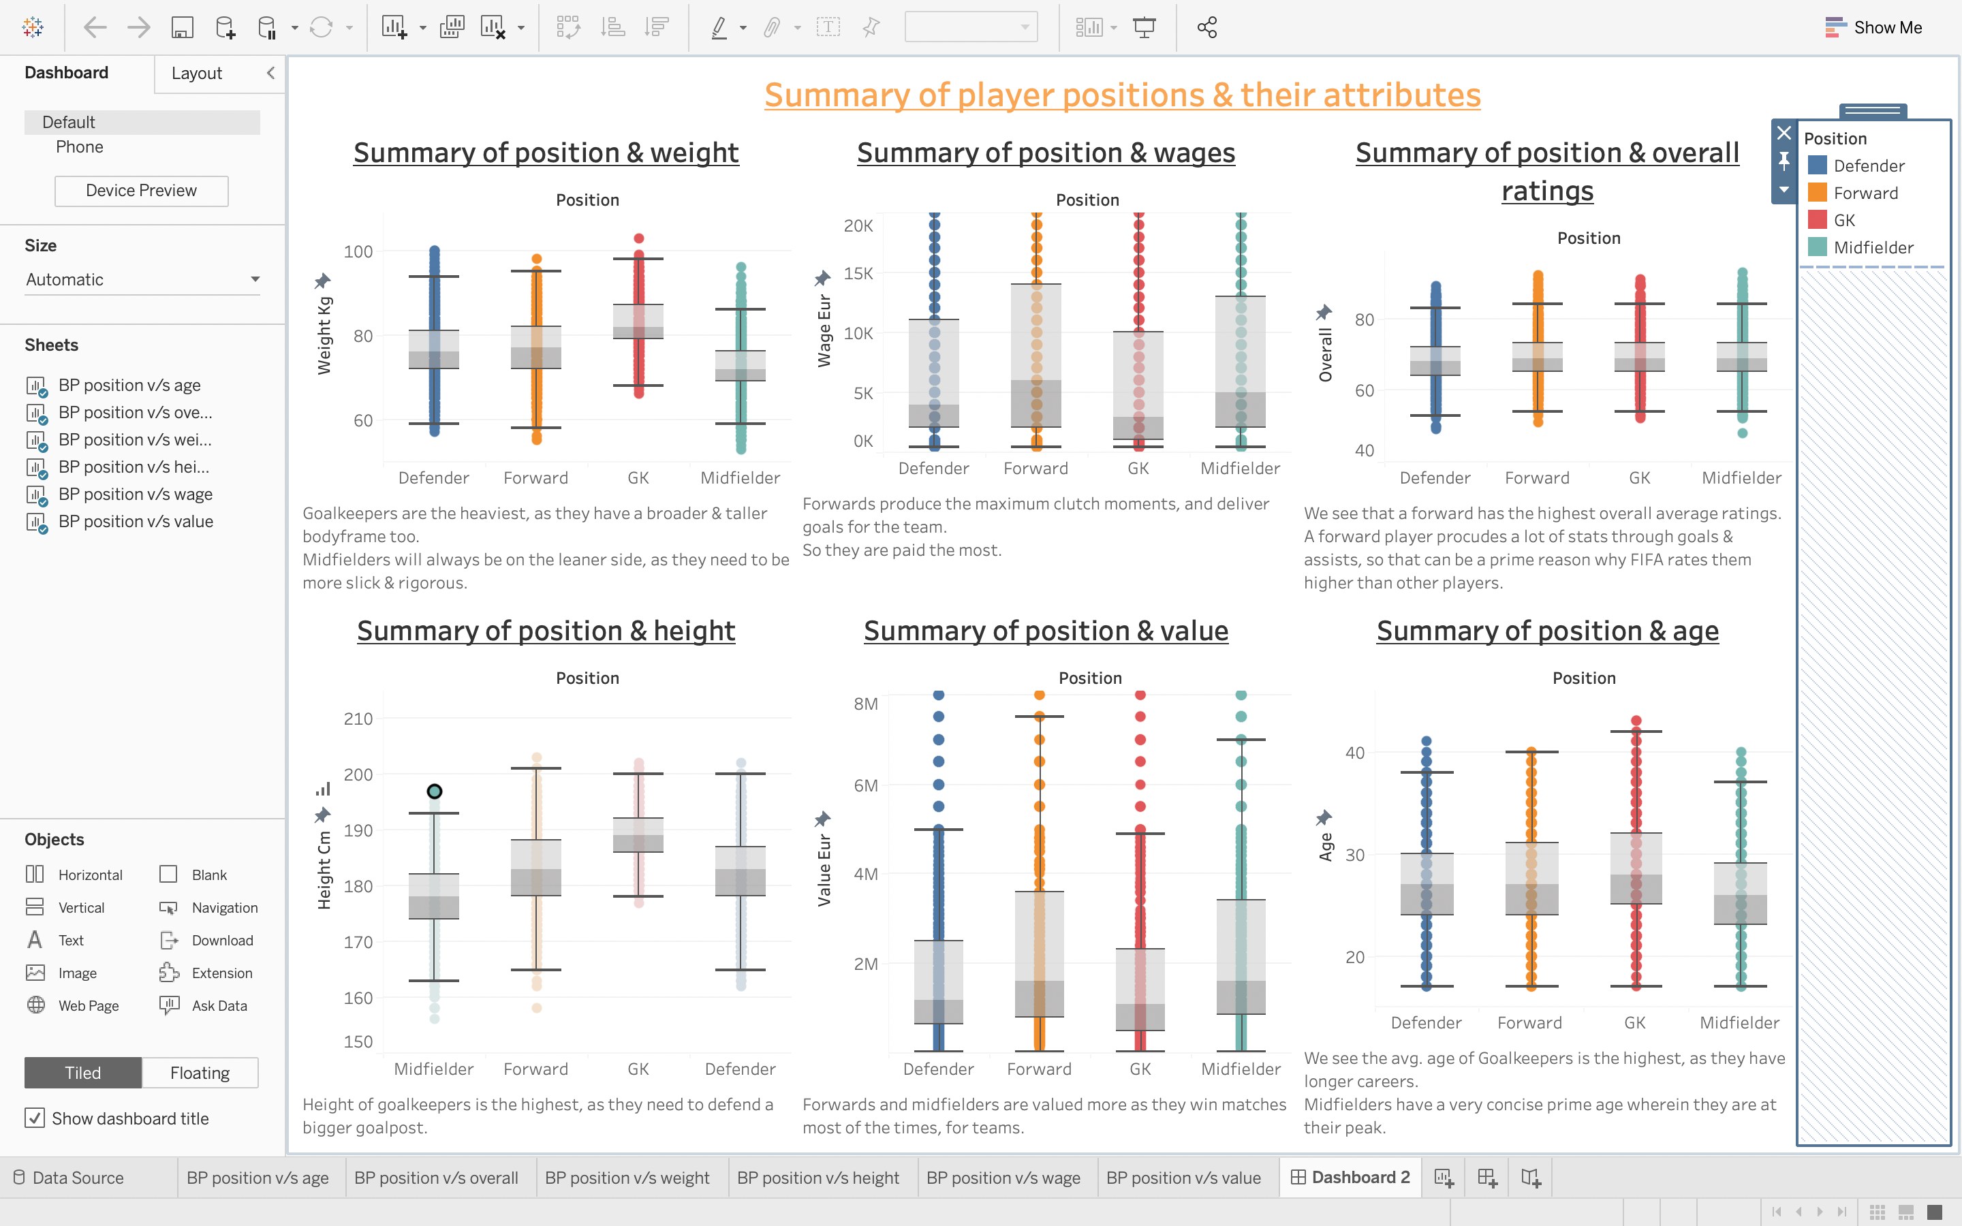
Dashboard 5

Slide 17
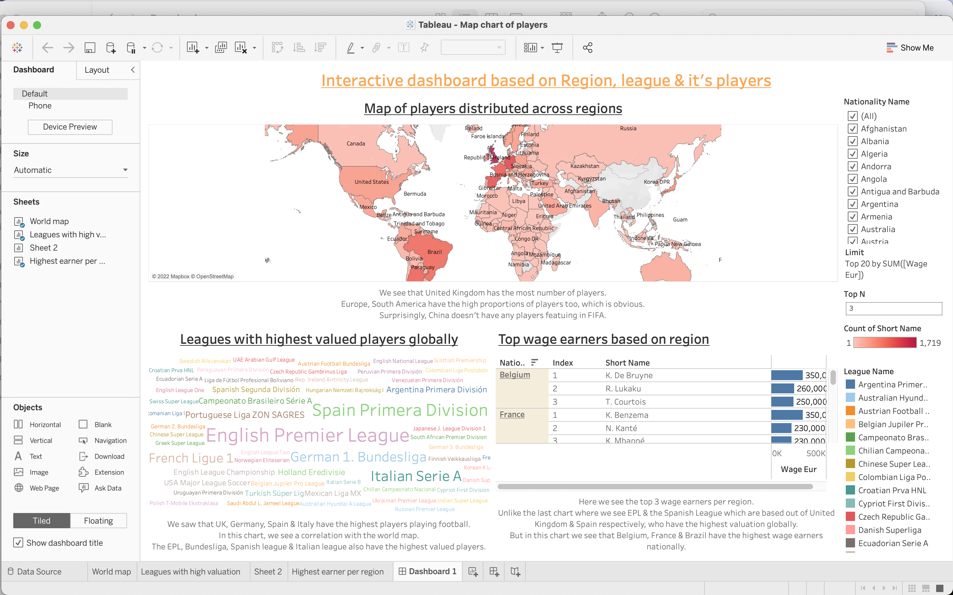
Dashboard 6

Slide 18
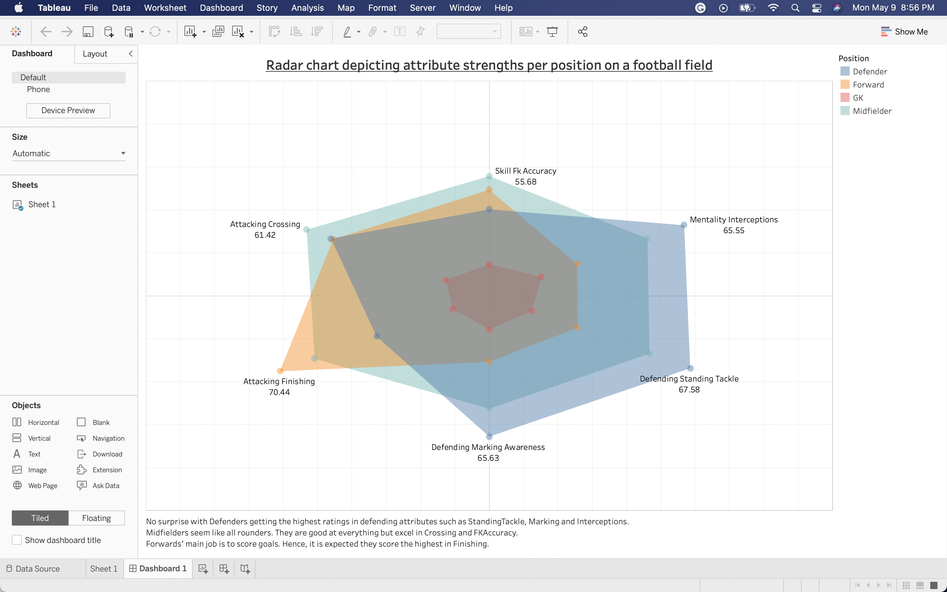
Dashboard 7

Slide 19
Key learnings through this project:
Apt data cleaning & EDA gives clarity
Choosing the right charts helps give clear insights
Getting hands-on exposure to Tableau’s advanced techniques like calculated fields, joins, unions, parameters, dashboards & storyboards helps in analyzing the data even better
Understanding holistically how Tableau can be such a crucial tool to understand the macro as well as micro facets of a business.

